Slide 1
UNIT 7: STELLAR SPECTRA & CLASSIFICATION

Slide 2
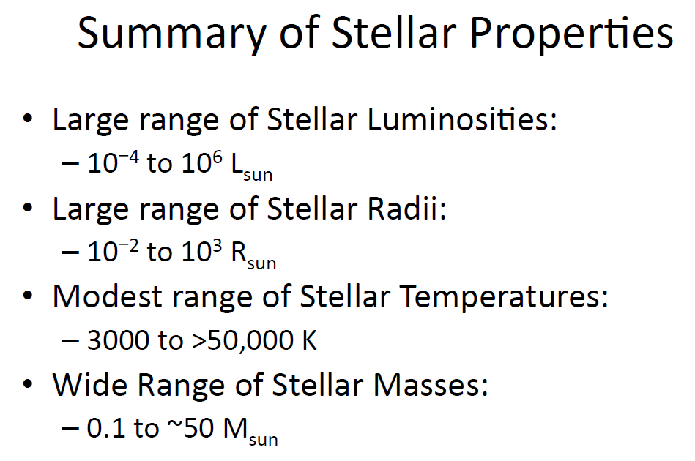

Slide 3
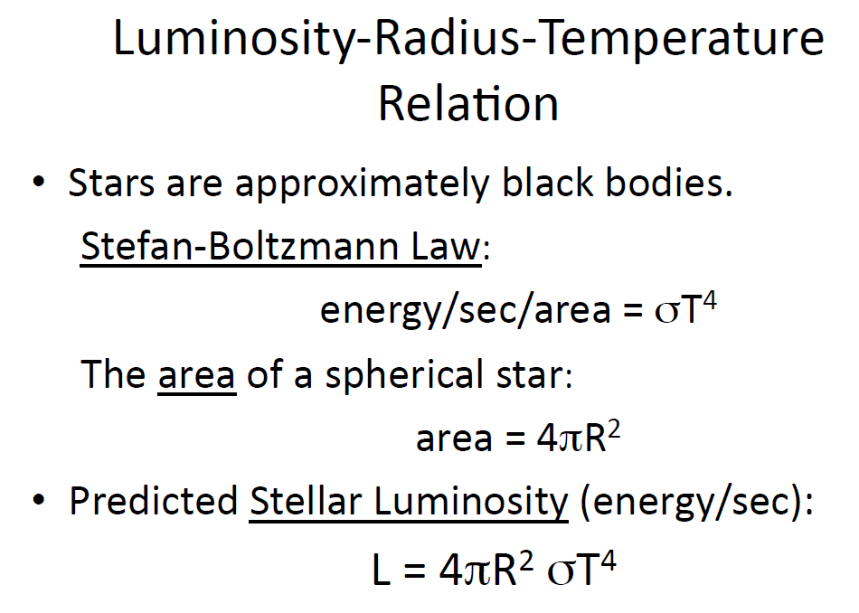

Slide 4
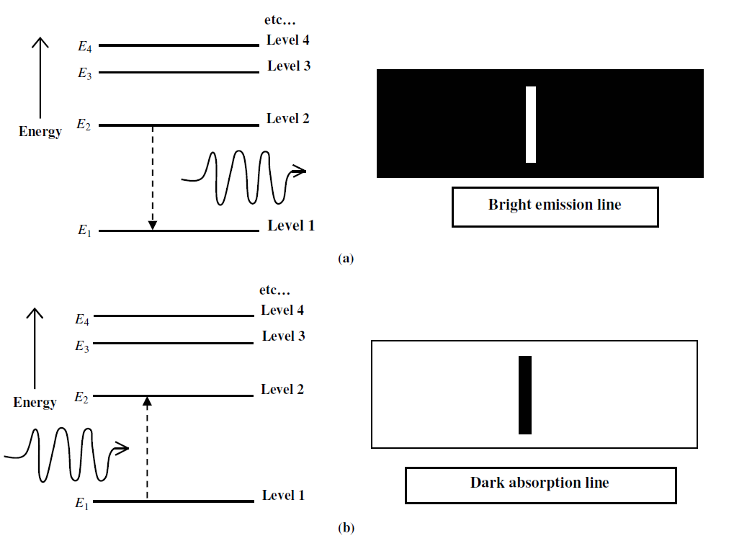

Stellar Spectra

Slide 5
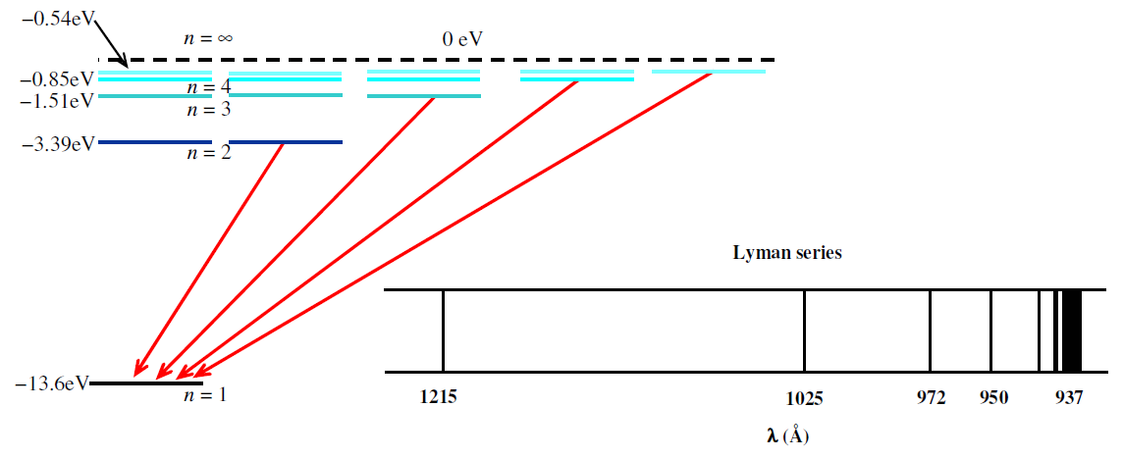
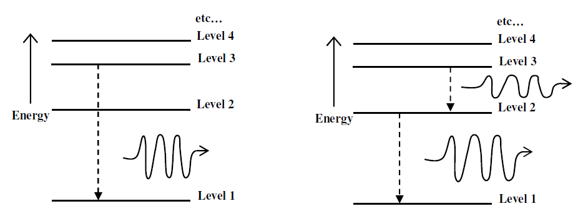

Slide 6
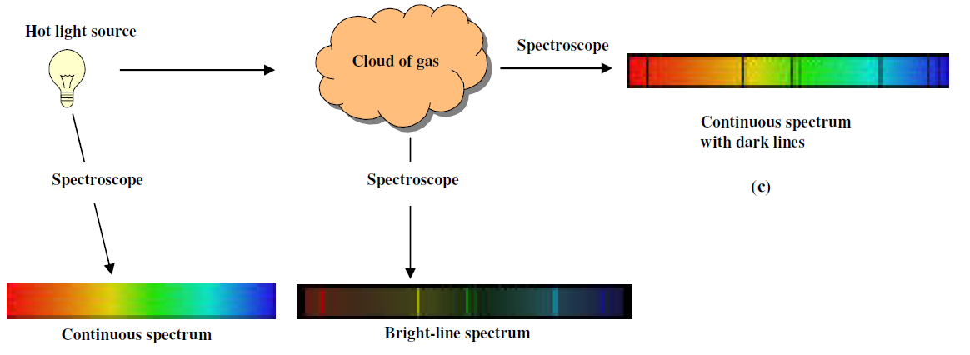
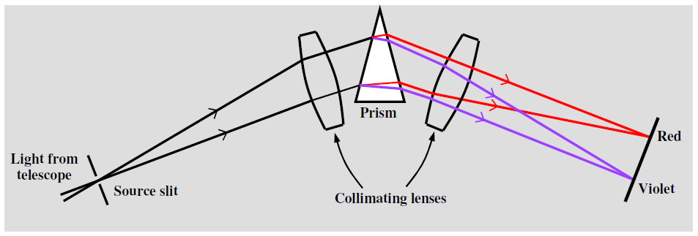

Slide 7
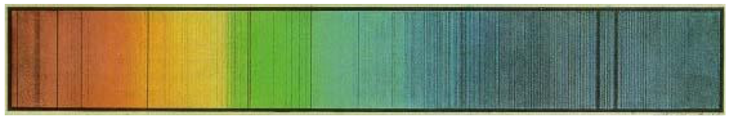
DARK LINES → ABSORPTION SPECTRA
BRIGHT LINES → EMISSION SPECTRA
OVER CONTINUOUS SPECTRUM
RELATIVE SPACING OF LINES → ELEMENTS PRESENT
INTENSITY OF LINES → ABUNDANCE OF ELEMENTS

Slide 8
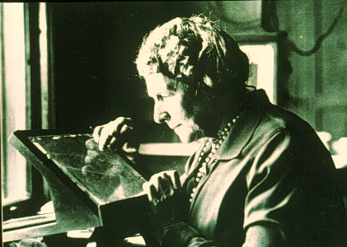
A bit History
1814 Joseph Frauenhofer, an optician in Munich, discovered many dark lines crossing the spectrum of the Sun.
1890s Edward Pickering, director of the Harvard College Observatory, started a project to get spectra of all the stars in the sky down to ~8th magnitude.
1910s Annie Jump Cannon and others working at Harvard developed an empirical scheme for classifying the spectra.

Slide 9
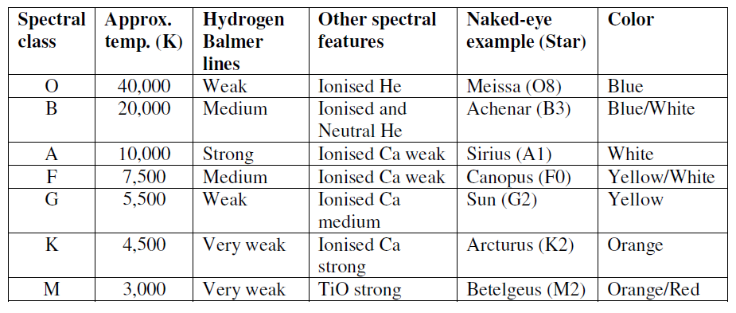
TO INVOLVE ANY TRANSITION TO n = 2 LEVEL OF H-GAS, WE NEED TO HAVE ATLEAST A TEMPERATURE OF 7945 K.
TO COMPLETELY IONIZE THE GAS, WE NEED ATLEAST 32000 K.

Slide 10
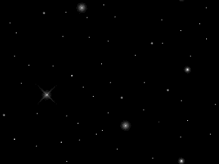
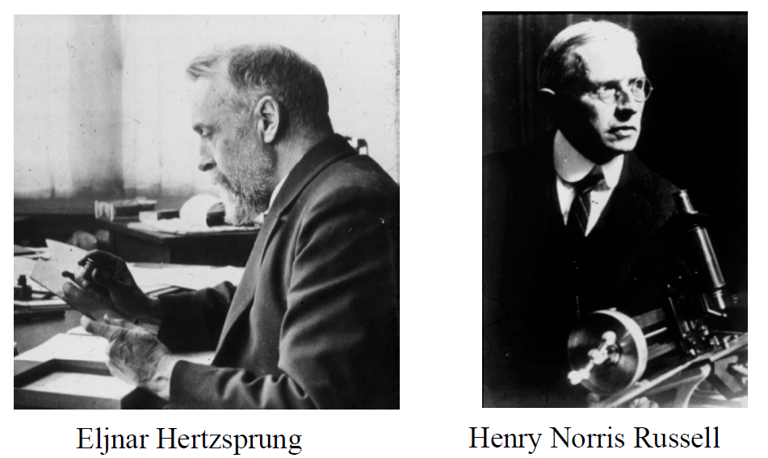
The HERTZSPRUNG RUSSEL DIAGRAM
A classification system for stars. It organizes stellar information by making a correlation between a stars luminosity (absolute magnitudes) and a its temperature.
Developed in the 1920’s

Slide 11
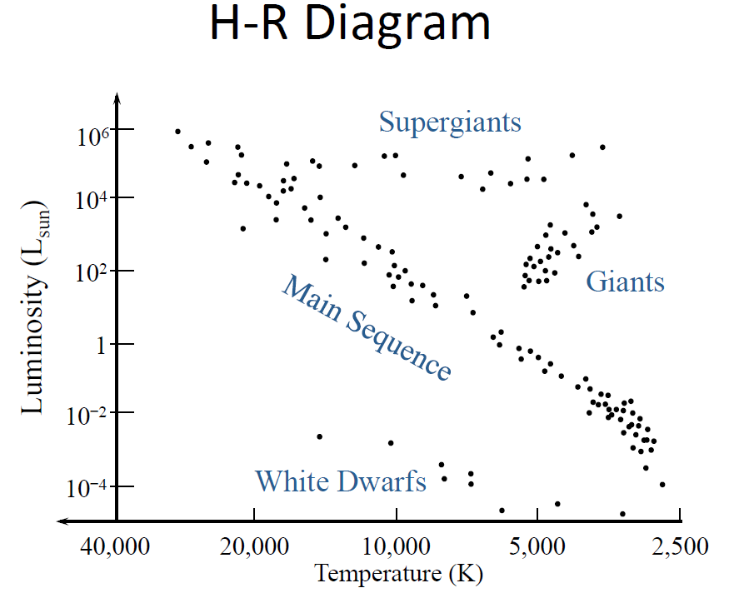


Slide 12
https://astro.unl.edu/mobile/HRdiagram/HRdiagramStable.html
https://d1lexza0zk46za.cloudfront.net/astronomy/simulations/HR_Diagram/index.html

Slide 13
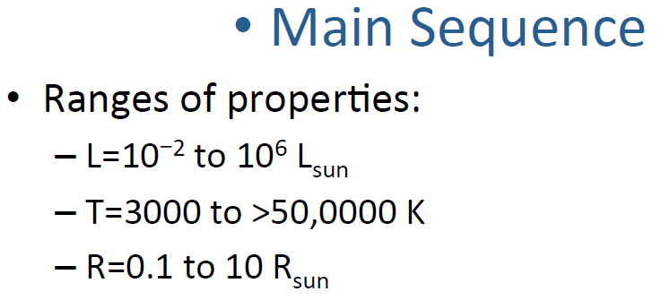
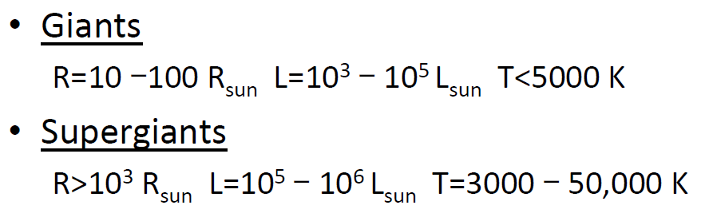
https://chandra.harvard.edu/edu/formal/variable_stars/bg_info.html
http://spiff.rit.edu/classes/ladder/lectures/ordinary_stars/ordinary.html

Slide 14
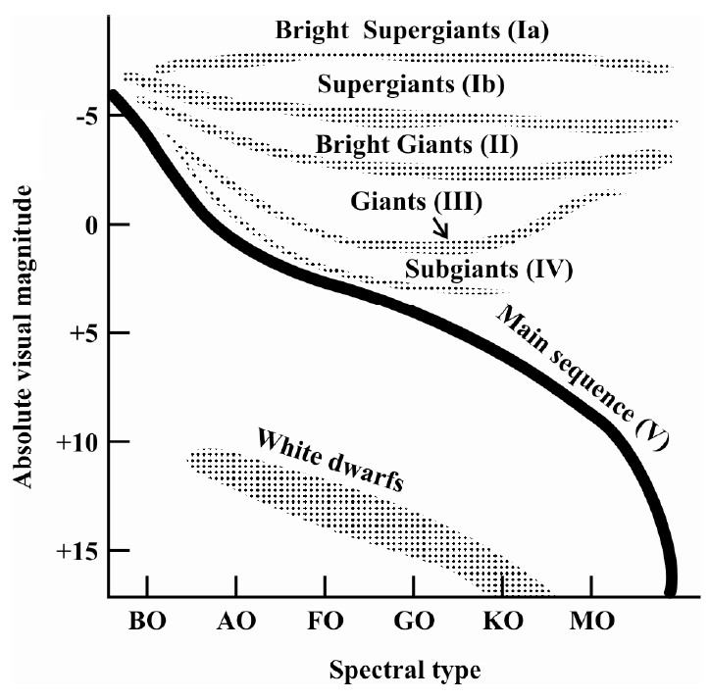
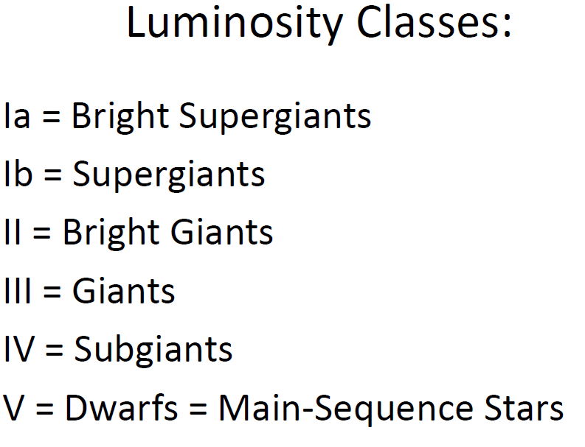
VII = White dwarves

Slide 15
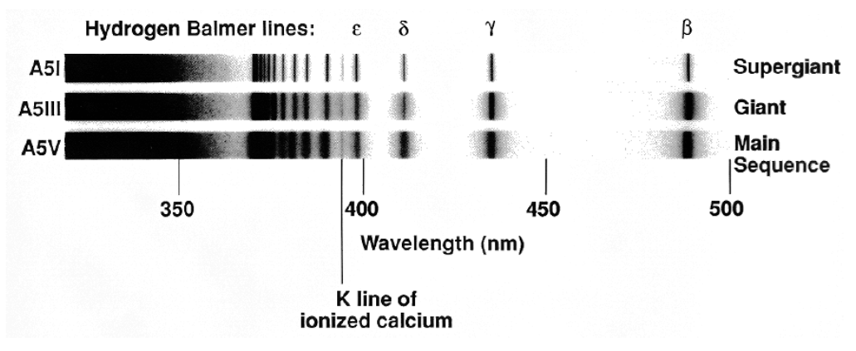
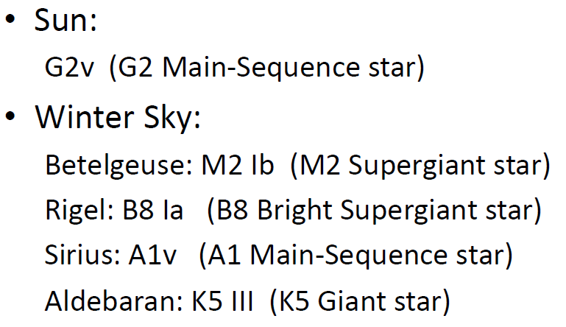
The spectral classes O through M, as well as other more specialized classes discussed later, are subdivided by Arabic numerals (0–9), where 0 denotes the hottest stars of a given class. For example, A0 denotes the hottest stars in class A and A9 denotes the coolest ones.

Slide 16
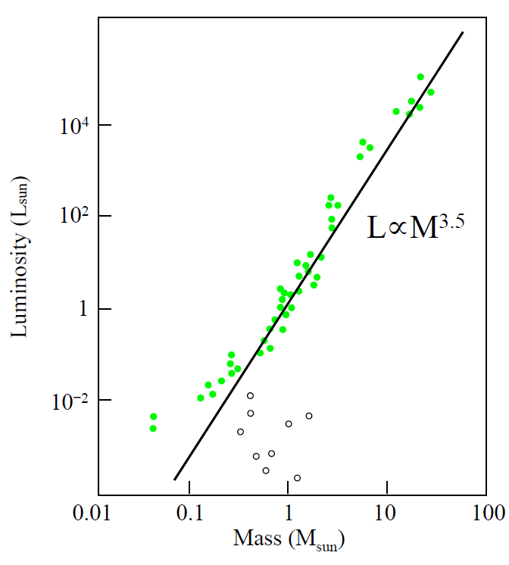
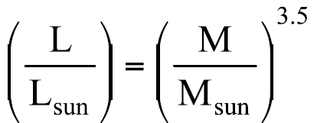

Slide 17
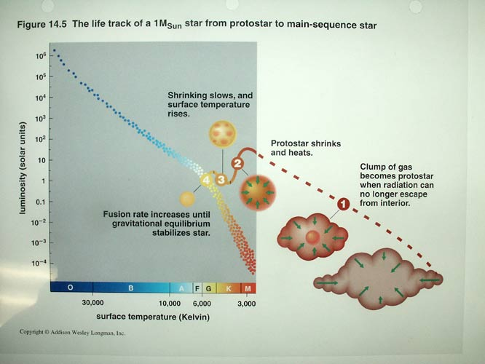

Slide 18
IN THE MAIN SEQUENCE
LIFE TIME
τ = M/L
τ α M^{-2.5}
USING SOLAR PARAMETERS
τ/τ_{O} α (M/M_{O})^{-2.5}

Slide 19
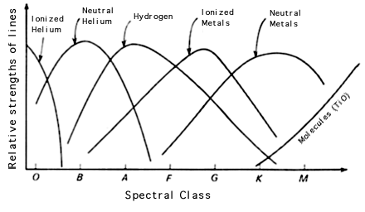

Slide 20
Color | Class | Solar M | solar D | T(K) | Prominent Lines
bluest | O | 20 - 100 | 12 - 25 | 40,000 | ionized helium
bluish | B | 4 - 20 | 4 - 12 | 18,000 | neutral helium, neutral hydrogen
blue-white | A | 2 - 4 | 1.5 - 4 | 10,000 | neutral hydrogen
white | F | 1.05 - 2 | 1.1 - 1.5 | 7,000 | neutral hydrogen, ionized calcium
yellow-white | G | 0.8 - 1.05 | 0.85 - 1.1 | 5,500 | neutral hydrogen, strongest ionized calcium
orange | K | 0.5 - 0.8 | 0.6 - 0.85 | 4,000 | neutral metals (calcium, iron), ionized calcium
red | M | 0.08 - 0.5 | 0.1 - 0.6 | 3,000 | molecules and neutral metals

Slide 21
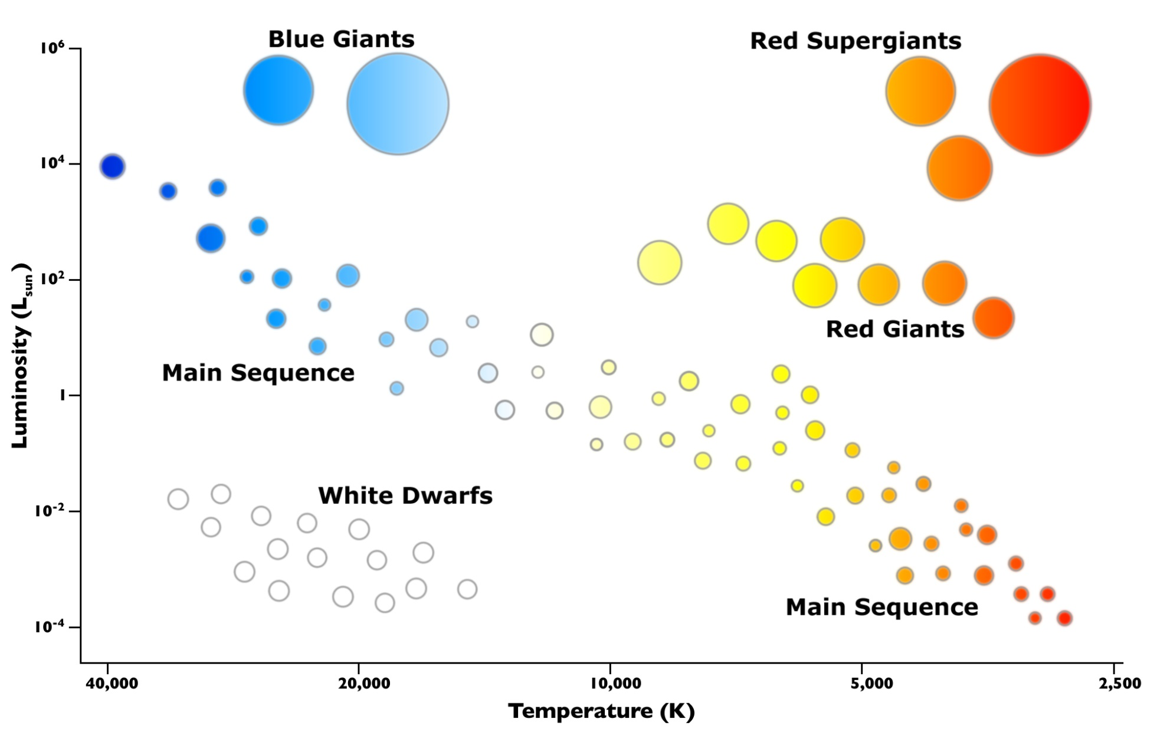


HR Diagram

Slide 22
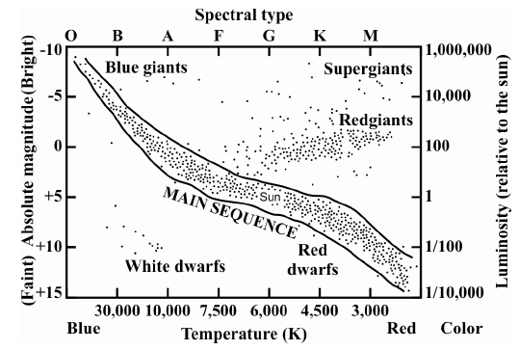

Slide 23
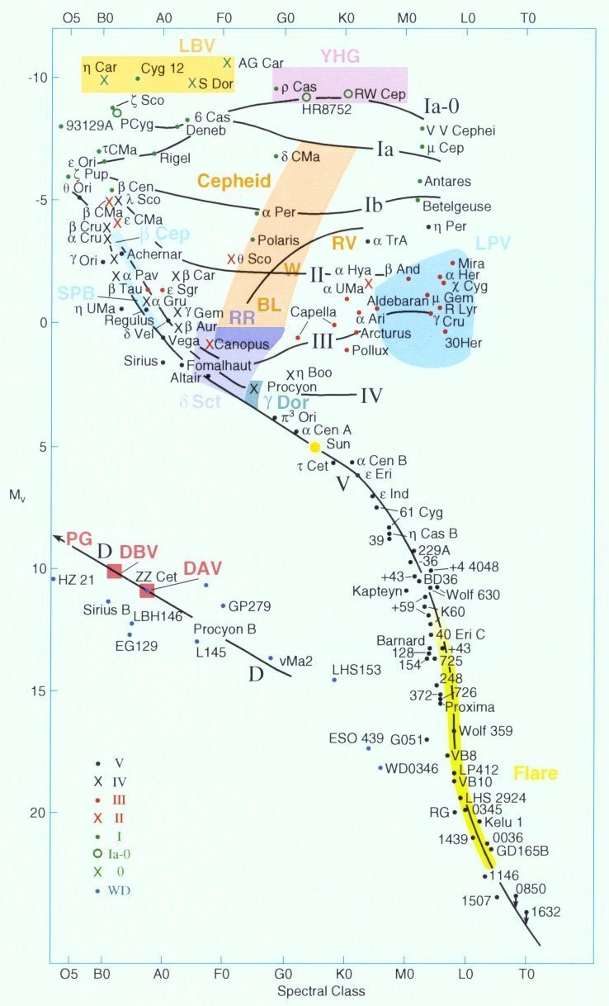
Variable Stars

Slide 24
Variable Stars
Because of some instability, stars can vary in brightness in a remarkable variety of ways, some pulsating, others erupting or flaring.
There is a periodicity attached to them. Variability can be in years, months, days or even hours !!
Widely believed to be a transient phenomenon.

Slide 25
Types (Periodicity)
Luminous Blue Variable (LBV) Stars (Decades),
YHG (Dusty Outbursts),
Long Period Variable (LPV) (100 – 600 days)
SPB (100 – 600 days, slow)
Cephieds (1 - 100 days, Population I, Population II)
Information that they give:
Rate of Stellar Processes.
Rate at which Star Life proceeds.
Distance estimation.
Luminosity, Radius, Mass …….

Slide 26
Exercise: plot HR diagram of Pleiades cluster
https://www.atnf.csiro.au/outreach/education/senior/astrophysics/stellarevolution_pleiadesact.html

